Slide 1
Design & Implement Community Portal Database
Module Project
Module: Database Design and Implementation
Course: NICF-Advanced Certificate in Infocomm Technology (Software & Applications)
Start Date : 21 July 2022
End Date : 9 August 2022
Submission Date : 5 August 2022
Learner Name : Ida Bagus Ketut Yoghantara
Enrollment ID :
Presentation Date :

Slide 2
Contents
Document History
Version Number | Effective Date of release | Summary of Included Changes | Author
1 | 4th March 2016 | First Edition | Satya CVS
4 | 26th July 2017 | Changed for Module 4 | Shrinivas K R
5 | 5th June 2018 | Changed for Module 4 RQF | Shrinivas K R

Slide 3
Contents
Contents
S. No. | Description
01 | Development Tools
02 | Database Requirements
03 | Entities
04 | Conceptual Design
05 | Logical Design
06 | Tables
07 | Fields
08 | SQL Queries
09 | Report Queries
10 | Indexes
11 | Backup Script
12 | Project Milestones & Tasks
13 | Milestone Feedback & Action Taken
14 | Project Results
15 | Proposed Improvements

Slide 4
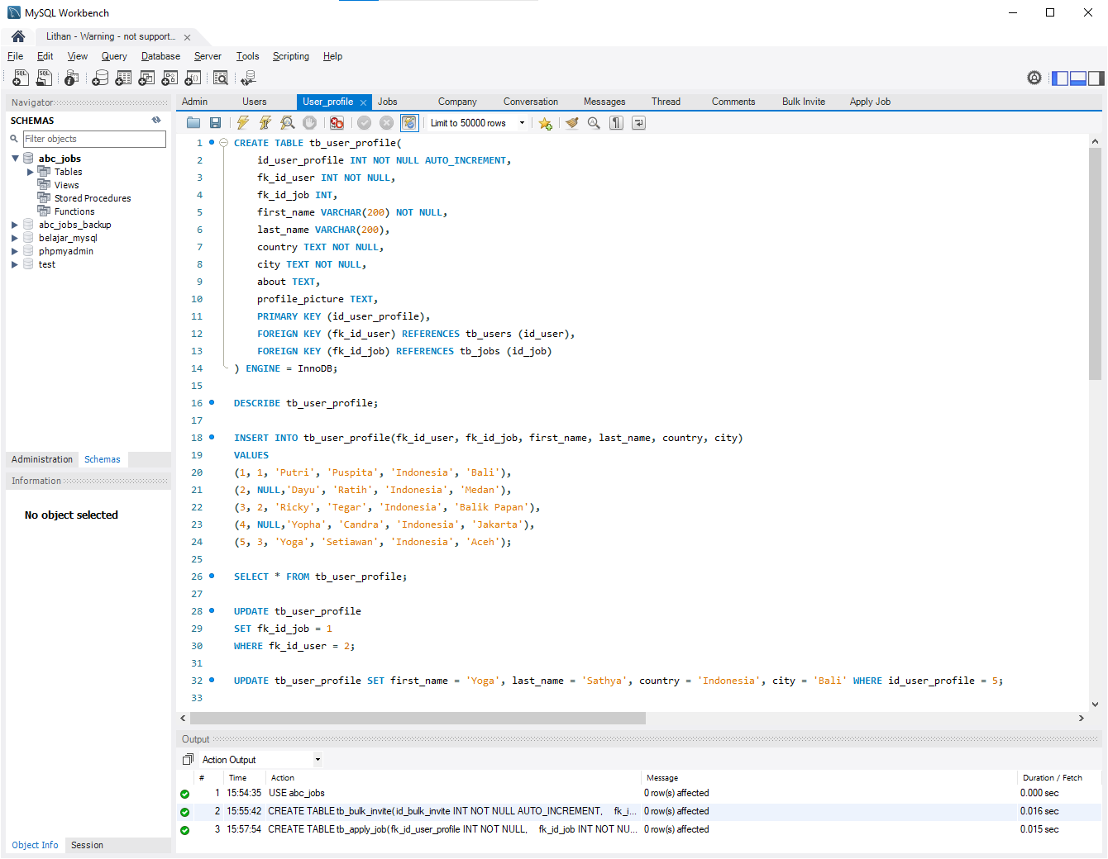
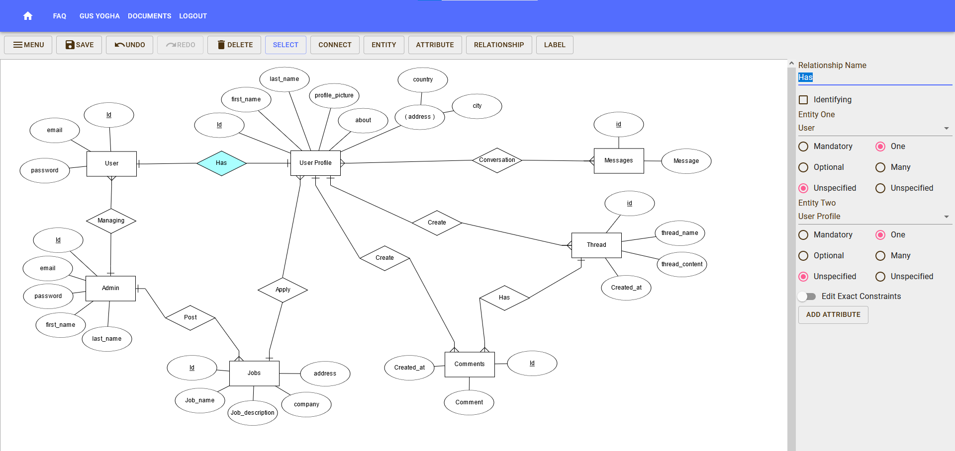
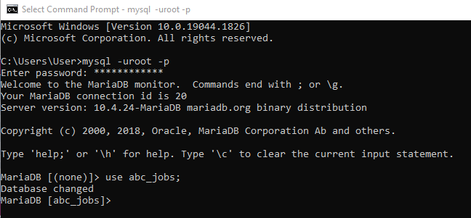
1. Development Tools
Development Tools Screen captures
MySQL Workbench
ERDPlus
Command Prompt

Slide 5
2. Database Requirements
Hardware Requirements
Minimum:
a. 2 CPU Cores
b. 2 GB Ram
c. Disk I/O subsystem applicable to a write-intensive database
Recommended:
a. 4 CPU Cores
b. 8 GB Ram
c. Disk I/O subsystem applicable to a write-intensive database
Software Requirements
a. MySQL 8.0
b. PHP MyAdmin
c. Apache 2.4

Slide 6
3. Entities
Entities
S. No. | Entities | Description
1 | Admin | Administrator of the website who managed the website and all the data of the users
2 | Users | The person that using this website to find a job or whatever the website provides
3 | User Profile | Information about users who registered on the website
4 | Jobs | Information about all of the job’s opportunity in the website
5 | Messages | Chat message between users who used the website
6 | Threads | A running commentary of text messages pertaining to one topic or question
7 | Comments | Comment is replies from the user for the existing thread or topics

Slide 7
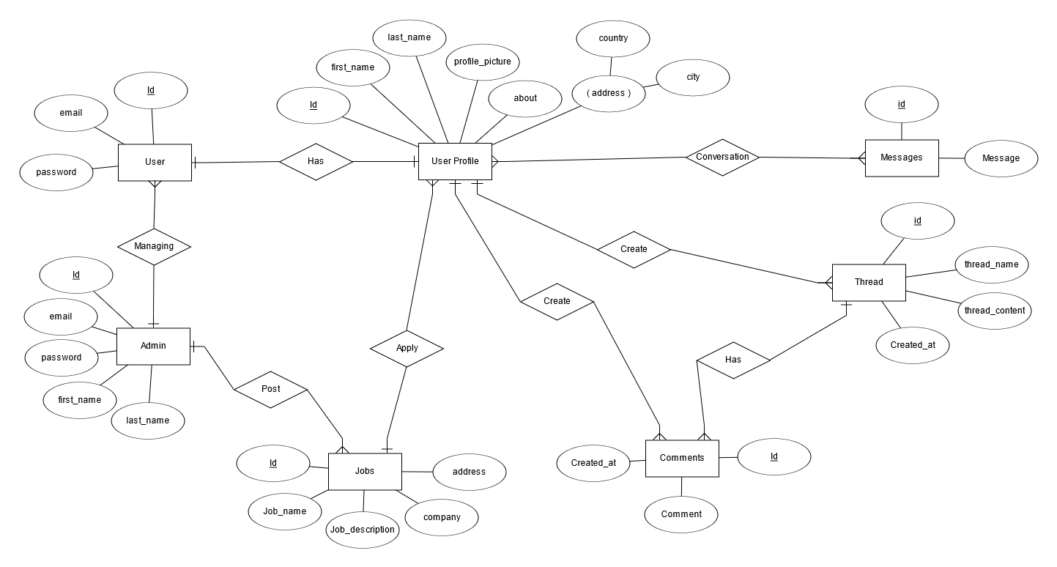
4. Conceptual Design

Slide 8
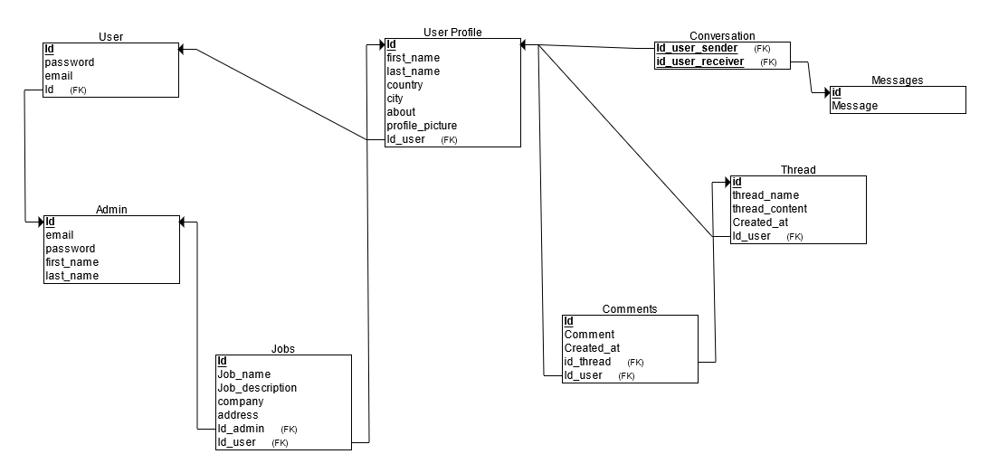
5. Logical Design

Slide 9
6. Tables
Tables
S. No. | Tables | Purpose of Table
1 | Tb_admin | Storing admin account information
2 | Tb_users | Storing user data for login
3 | Tb_user_profile | Storing user profile data that will be used to display profile page, search user and more
4 | Tb_jobs | Storing job opportunities and for user to apply job
5 | Tb_company | Storing company data separately from jobs for easier management
6 | Tb_conversation | Storing conversation history for user to chat with each other on the website
7 | Tb_messages | Storing all the messages from conversation by the users
8 | Tb_thread | Storing thread data and information
9 | Tb_comments | For storing comments in thread section
10 | Tb_bulk_invite | For storing bulk invite data by the admin to send bulk invite email to the users
11 | Tb_apply_job | Storing all the data from user whom applying for job

Slide 10
7. Fields
One Table for Each Table
tb_admin
tb_users
S. No. | Field | Description
1 | Id_admin | Primary key for admin table
2 | Email | Admin email
3 | Password | Admin password
4 | First_name | Admin first name
5 | Last_name | Admin last name
S. No. | Field | Description
1 | Id_user | Primary key for users table
2 | Email | Email user for login
3 | Password | User password for login

Slide 11
7. Fields
tb_user_profile
tb_jobs
S. No. | Field | Description
1 | Id_user_profile | Primary key for user profile table
2 | Fk_id_user | Foreign key from users table
3 | Fk_id_job | Foreign key from jobs table
4 | First_name | User profile first name
5 | Last_name | User profile last name
6 | Country | User profile country
7 | City | User profile City
8 | About | User profile about
9 | Profile_picture | User profile picture
S. No. | Field | Description
1 | Id_job | Primary key for jobs table
2 | Fk_id_admin | Foreign key from admin table
3 | Fk_id_company | Foreign key from company table
4 | Job_name | Name of job opportunities
5 | Job_description | Description for the job

Slide 12
7. Fields
tb_company
tb_conversation
S. No. | Field | Description
1 | Id_company | Primary key for company table
2 | Company_name | Name of the company
3 | Country | Company country
4 | City | Company city
5 | Company_picture | Company logo / picture
S. No. | Field | Description
1 | Id_conversation | Primary key for conversation table
2 | Fk_id_from | Foreign key from user profile table
3 | Fk_id_to | Foreign key from user profile table

Slide 13
7. Fields
tb_messages
tb_thread
S. No. | Field | Description
1 | Id_message | Primary key for messages table
2 | Fk_id_conversation | Foreign key from conversation table
3 | Is_from_sender | Boolean value to store it’s from the sender of the first message or not
4 | Message | Message from user
5 | Time_sent | Timestamp for when the messages are sent
S. No. | Field | Description
1 | Id_thread | Primary key for thread table
2 | Fk_id_user_profile | Foreign Key from user profile table
3 | Thread_name | Name of the thread
4 | Thread_content | Thread content
5 | Created_at | Timestamp for when the thread was created

Slide 14
7. Fields
tb_comments
tb_bulk_invite
Tb_apply_job
S. No. | Field | Description
1 | Fk_id_thread | Foreign Key from thread table
2 | Fk_id_user_profile | Foreign Key from user profile table
3 | Comment | Comment from the thread
4 | Time_sent | Timestamp for when the comments were sent
S. No. | Field | Description
1 | Id_bulk_invite | Primary key for bulk invite table
2 | Fk_Id_admin | Foreign Key from admin table
3 | Email_title | Email title for the bulk invite
4 | Email_content | Email content for the bulk invite
S. No. | Field | Description
1 | Fk_id_user_profile | Foreign Key from user profile table
2 | Fk_id_job | Foreign Key from jobs table

Slide 15
8. SQL Queries
S. No. | Purpose of Query | Query
1 | For admin login | SELECT id_admin, email, password FROM tb_admin;
2 | For users login | SELECT id_user, email, password FROM tb_users;
3 | Displaying user profile | SELECT * FROM tb_user_profile;
4 | Updating user profile | UPDATE tb_user_profile SET first_name = ‘<name>', last_name = ‘<name>', country = ‘<country>', city = ‘<city>' WHERE id_user_profile = <id>;
5 | Input email and password from registration | INSERT INTO tb_users (email, password) VALUES (‘<email>’, ‘<password>');
6 | Input user profile from registration | INSERT INTO tb_user_profile (fk_id_user, first_name, last_name, country, city) VALUES (<id_user>, ‘<name>', ‘<name>', '<country>', ‘<city>');
7 | Sending conversation message | INSERT INTO tb_messages (fk_id_conversation, is_from_sender, message, time_sent) VALUES (1, true, 'test message', '2022-12-30 12:10:10'), (1, false, 'test reply message', '2022-12-30 12:10:11');
8 | Read messages | SELECT C.id_conversation, C.fk_id_from, C.fk_id_to, M.is_from_sender, M.message, M.time_sent FROM tb_messages AS M INNER JOIN tb_conversation AS C ON (M.fk_id_conversation = C.id_conversation) WHERE M.fk_id_conversation = 1;

Slide 16

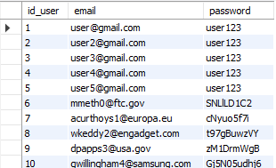
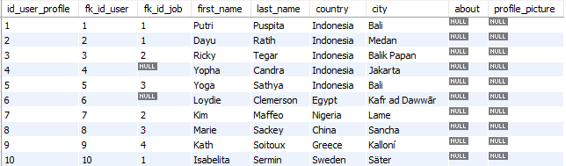
9. Report Queries
For admin login
For users login
Displaying user profile

Slide 17
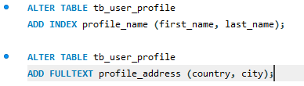

10. Indexes
Tb_user_profile
Tb_jobs

Slide 18
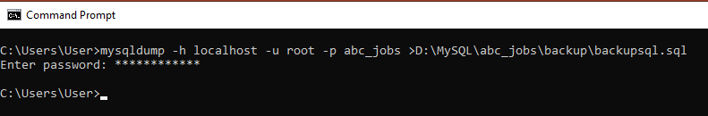
11. Backup Script
Backup Script
mysqldump -h localhost –u root –p abc_jobs > D:\MySQL\abc_jobs\backup\backupsql.sql
Restoration Script
mysql -h localhost -u root -p abc_jobs_backup < D:\MySQL\abc_jobs\backup\backupsql.sql

Slide 19
12. Project Milestones & Tasks
Project Task ID | Project Major Task Description | Project Milestone ID
1 | Setup the Development Environment based on the Technical Development Environment | 1
2 | Power point detailing the entities, tables and fields which need to created | 1
3 | Power point will also include Conceptual, Logical Design | 1
4 | Develop the Schema creation script or Implement using phpMyAdmin | 2
5 | Power point which Analyze and list the Queries which need to be created based on project requirements | 3
6 | Indexes & Backup Script | 3

Slide 20
13. Milestone Feedback & Action taken
Project Milestone ID | Milestone Feedback received from Tutor / Learning Facilitator | Action Taken (Yes / No)
1 | Create indexes for user profile and jobs table | Yes

Slide 21
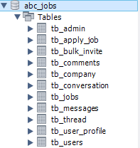
14. Project Results
List of Tables
  Tb_admin
  Tb_users
  Tb_user_profile
  Tb_jobs
  Tb_company
  Tb_conversation
  Tb_messages
  Tb_thread
  Tb_comments
  Tb_bulk_invite
  Tb_apply_job

Slide 22
15. Proposed Improvements
List of Improvements
  Create better logic for the database to prevent any error when it used by the users

